Slide 1
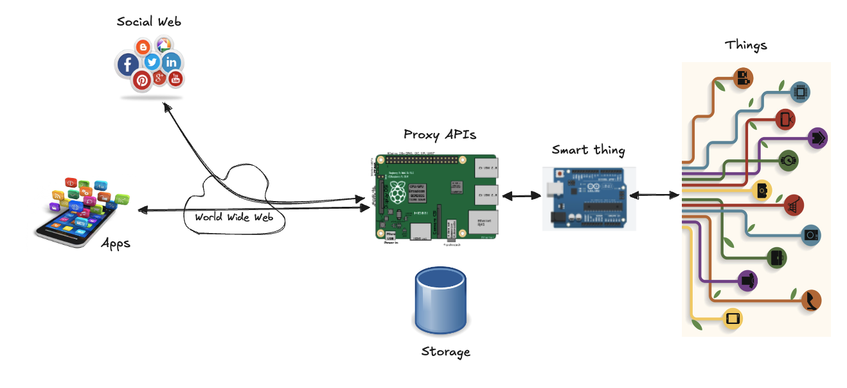
Sensors

Slide 2
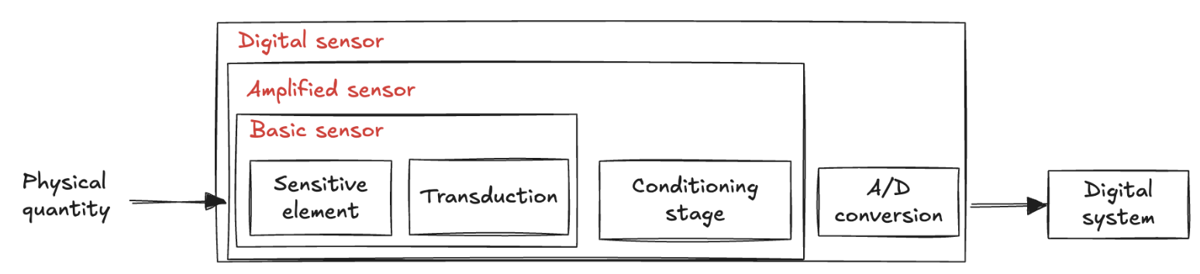
Sensor definition
A device detects physical properties or changes in the environment
temperature, light, motion, pressure, sound, etc
Converts this information (stimulus) into an electrical signal that can be read and processed by an electronic system
A sensor performance is defined by a set of key parameters that characterize its capabilities
how well a sensor can convert real-world signals into electrical signals
accuracy, response time, linearity, noise levels, etc
Notice the importance of environmental factors!
temperature and humidity can affect performance in real-world applications
we have to make informed decisions when designing systems

Slide 3
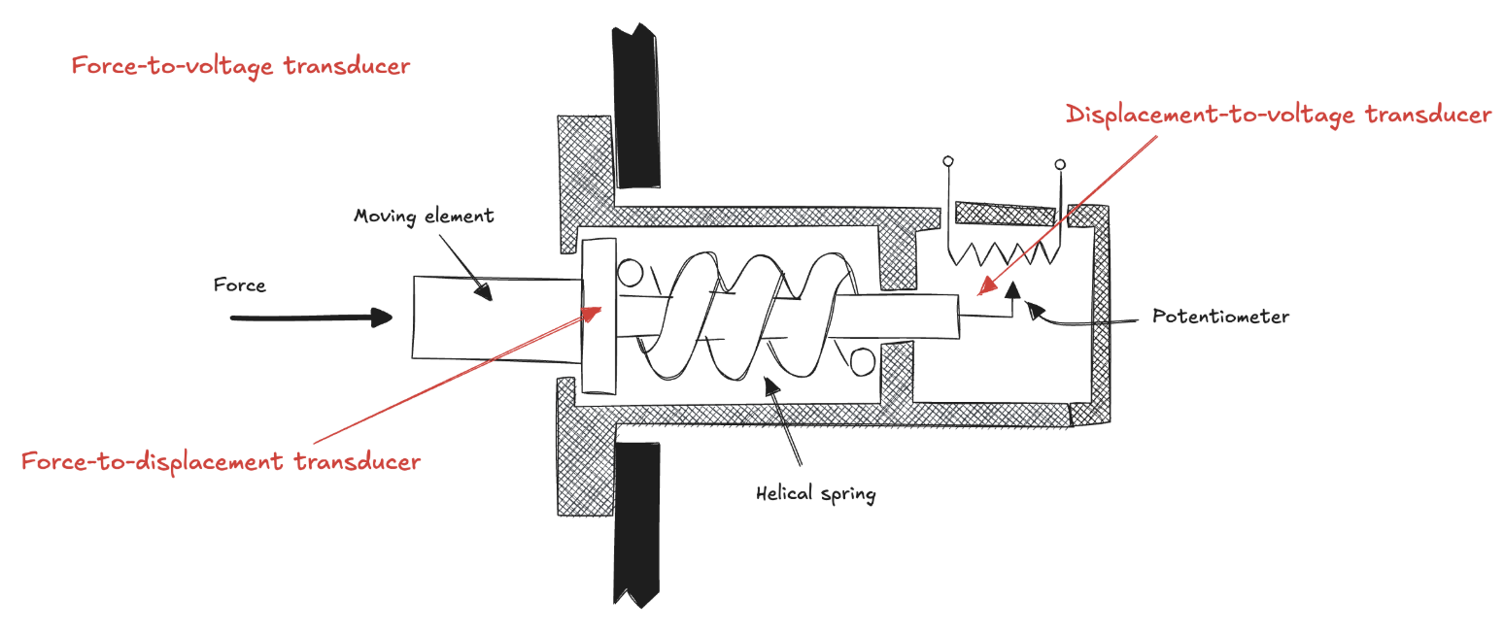
Transduction

Slide 4
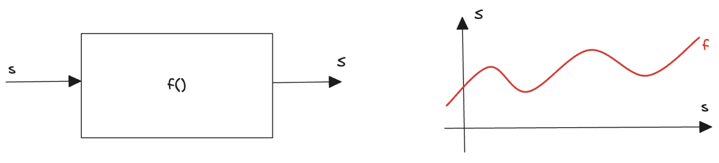
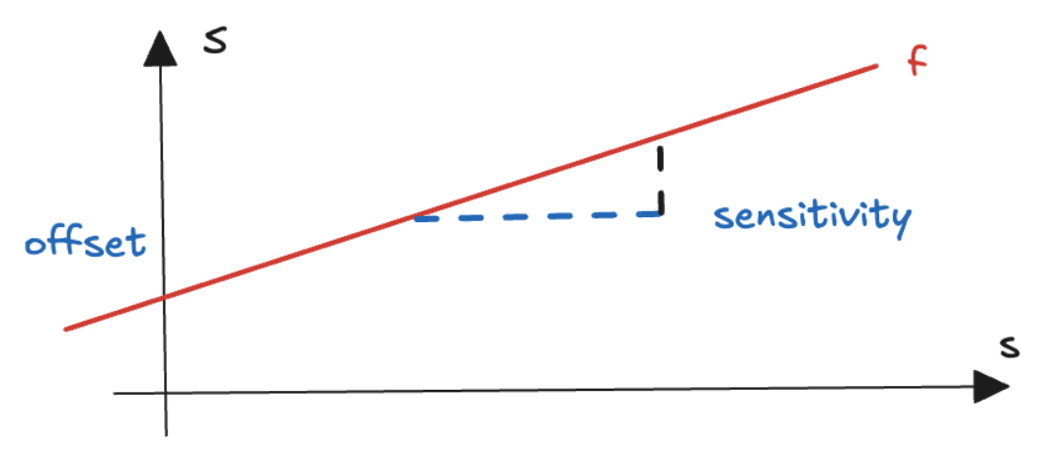
Transfer function
An ideal output-stimulus relationship
how the output corresponds to the input if the sensor were manufactured under ideal conditions S = f(s)
s is the input stimulus
S is one of the characteristics of the output electric signal (amplitude, frequency, phase, etc.)
It might be a simple linear relationship
S = a + b * s
a is the output signal at zero input (offset)
b is the slope (sensitivity)
how strongly output reacts to changes in input

Slide 5
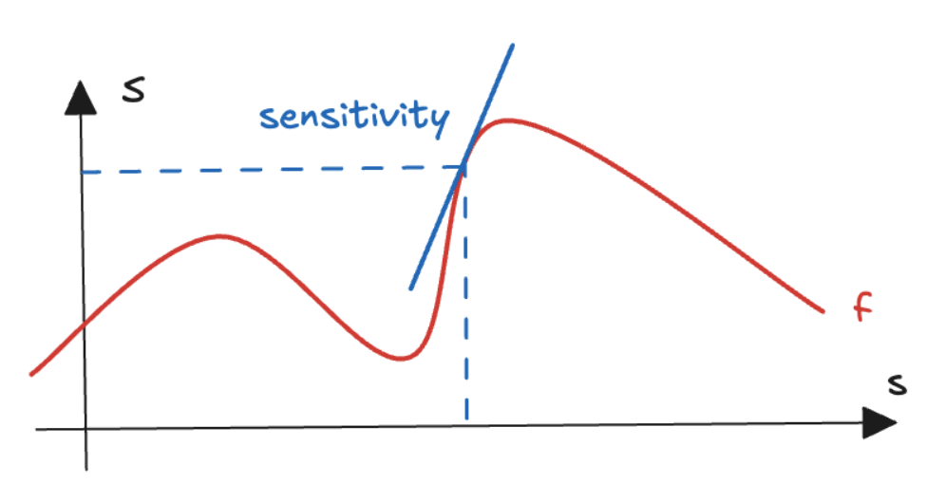
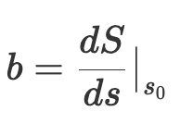
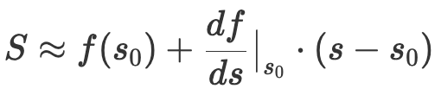
Non-linear transfer function
The function may be non-linear
such as logarithmic, exponential, or power functions
sensitivity varies with the input value
Transfer function can be approximated as linear function
for small changes in input, it behaves almost like a straight line
Mathematically: locally approximated by a first-order Taylor expansion
Linear approximation is valid only for small changes

Slide 6
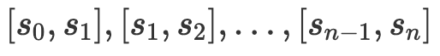
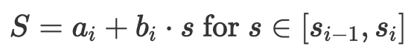
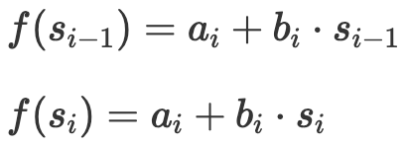
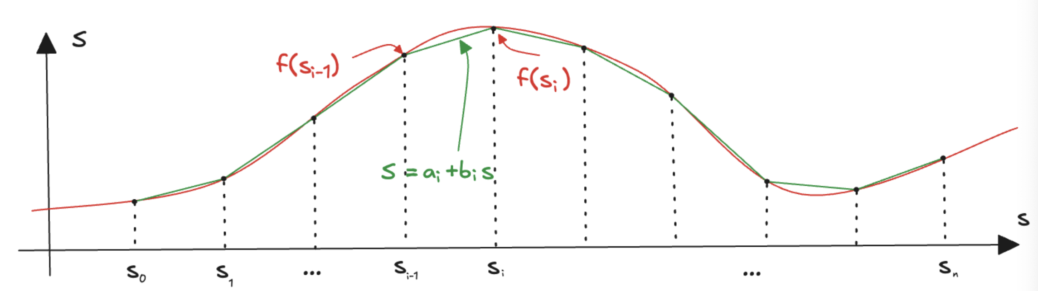
Piecewise approximation
For broader ranges, a piecewise approximation
Domain is divided into segments:
In each segment:
To ensure continuity between segments:
Closely follows the original non-linear function across the entire input range
Accuracy improves as the number of segments increases, but at the cost of increased complexity in modelling and computation

Slide 7
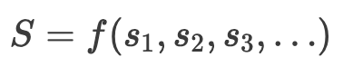
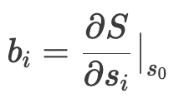
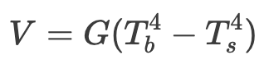
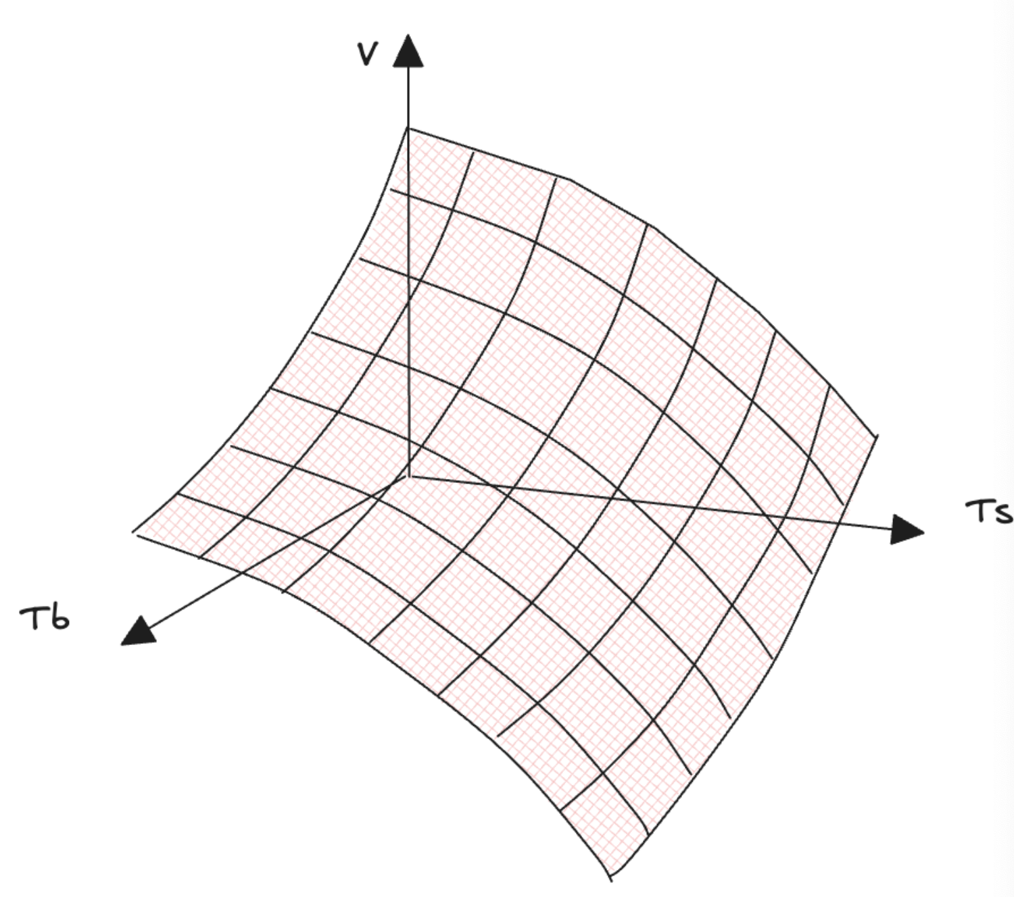
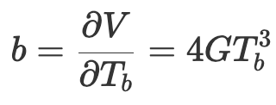
Multi-dimensional transfer function
The transfer function can involve multiple input variables
Sensitivity can be defined as the partial derivative of the output signal with respect to the particular input variable:
Common example: thermal radiation sensor
Output voltage depends on
temperature of the measured object (Tb)
temperature of the sensor surface (Ts)
G is constant that depends on the sensor’s properties
it shows non-linearity and dependence on the sensor surface temperature

Slide 8

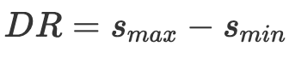
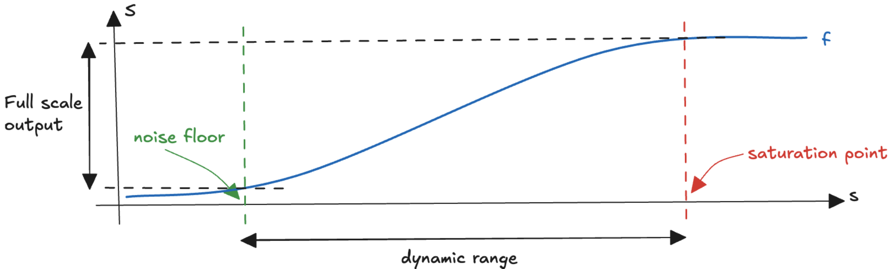
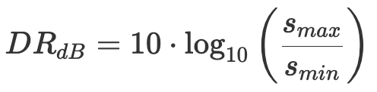
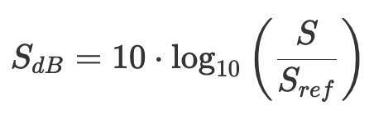
Dynamic Range
Quantifies the ability to operate effectively across a spectrum of signal intensities without distortion or loss of information
High dynamic range is particularly desirable (e.g. imaging, audio)
For very broad and nonlinear response characteristic, the dynamic range is often expressed in decibels
Human perception follows a similar logarithmic pattern

Slide 9

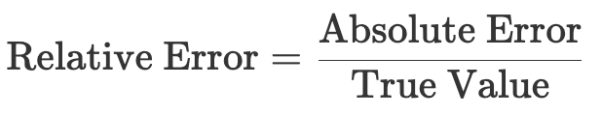
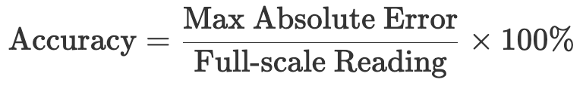
Accuracy
A sensor is a real device, and it is subject to imperfections and uncertainties that can affect its measurements
E.g. calibration inaccuracies, noise, or environmental factors, etc.
Deviation: difference between the measured value and the actual value
Mathematically, expressed in terms of absolute error and relative error
The accuracy is defined as the maximum deviation as a percentage of the sensor full-scale reading

Slide 10
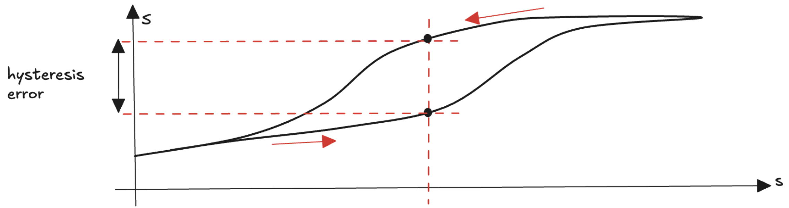
Hysteresis
The hysteresis error is a deviation of the output at a specified point of the input signal when it is approached from the opposite directions
E.g. a distance sensor produces different outputs when an object moves towards the sensor than when it moves away
Often caused by mechanical or thermal effects that introduce a memory effect

Slide 11
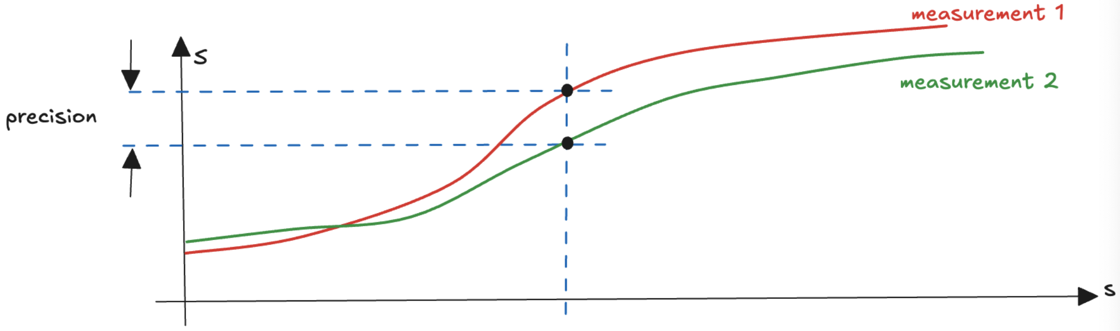
Precision
The ability of a sensor to produce consistent readings when the same stimulus is applied multiple time, under identical conditions
if we measure the same physical quantity multiple times with the same sensor, the sensor should give you very similar results each time, even if we perform the measurements at different moments
repeatability of the sensor performance
Crucial aspect of reliability

Slide 12
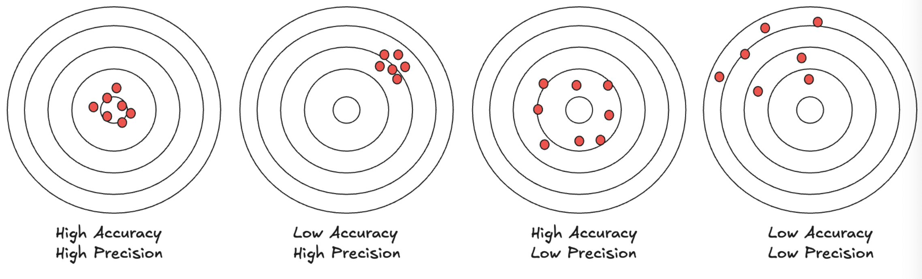
Precision vs Accuracy
Accuracy and precision are closely related but distinct concepts
Accuracy refers to how close the sensor output is to the true value
Precision focuses on the consistency of the sensor output when measuring the same quantity multiple times.
Accurate but not precise: it consistently produces the same error in its measurements
Precise but not accurate: it consistently produces the same output value that is different from the true value

Slide 13
Resolution
The smallest detectable change in the measured quantity that the sensor can distinguish
sensor ability to detect fine details
For analog sensors, the resolution is influenced by the noise and the precision of the measurement system
In digital sensors, the resolution is typically determined by the number of bits in the analog-to-digital converter (ADC)

Slide 14
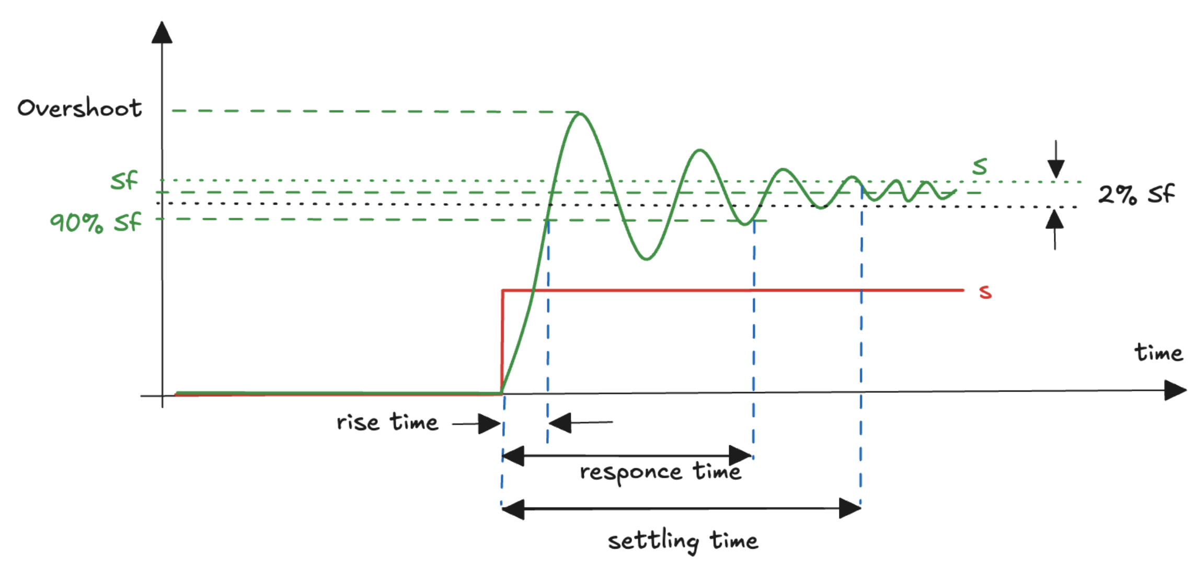
Dynamic characteristics
How the sensor responds to changes over time
its ability to track rapidly changing inputs

Slide 15
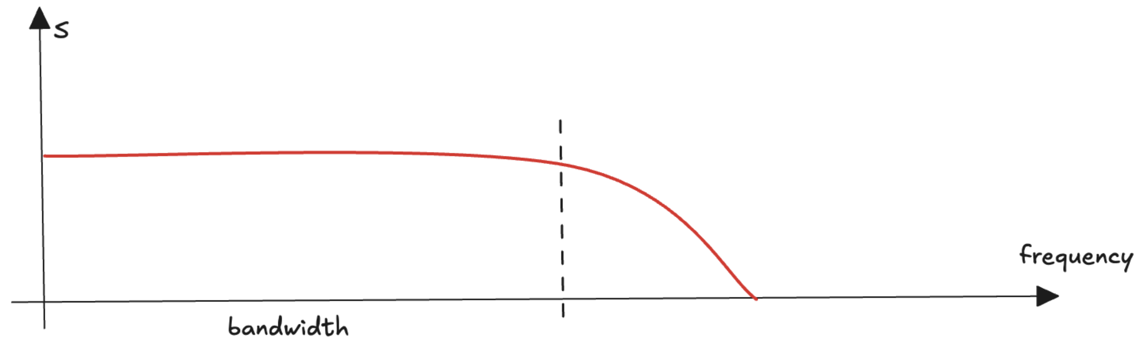
Frequency responce
Shows the magnitude and phase of the output as a function of the frequency of the input signal
The bandwidth is the range of frequencies over which the sensor can accurately measure the input signal

Slide 16

Reliability
The ability to consistently perform accurate measurements under specified conditions over a defined period
Typically expressed as the probability that the sensor will operate without failure or degradation in performance for a given duration or number of usage cycles.
Mean Time Between Failures (MTBF)
Reliability can be influenced by various factors
quality of the sensor components
manufacturing process
operating conditions
maintenance practices
A reliable sensor is essential in critical applications where sensor failure can have serious consequences

Slide 17
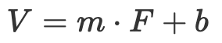
Calibration (1)
Adjusting and verifying the accuracy of a sensor by comparing its output to a known reference
Necessary because sensors can exhibit drift over time
due to factors like aging, temperature variations, or mechanical stress
Example:
we have a linear sensor to measure a force F that produces an output voltage
datasheet reports a sensitivity of m=0.2V/N and an offset of b=0.4V
however, we don't know if the sensor behaves exactly as expected!
we need to calibrate it!

Slide 18
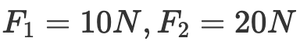
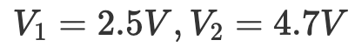
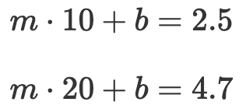
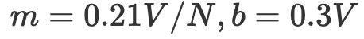
Calibration (2)
Calibration process:
Establishing a reference
Exposure to the reference value
Adjusting the sensor
Validation
repeat the process to verify that the output matches the reference value within an acceptable tolerance.
In practice, it is often more complex, involving multiple reference points, non-linear corrections, and detailed analysis of the sensor behaviour
The theory of measurement is a complex field that involves a deep understanding of physics, electronics, and signal processing

Slide 19
Context Awareness
Sensors can be used to detect and quantify various environmental parameters, enabling embedded systems to make informed decisions.
regulate room temperature
adjust display brightness
detect the presence of objects
Environments are dynamic, multifaceted with numerous interacting components
By measuring a wide range of parameters, we can achieve the context awareness, allowing systems to adapt to and interact intelligently with their surroundings

Slide 20
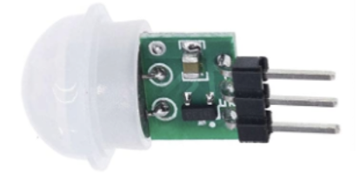
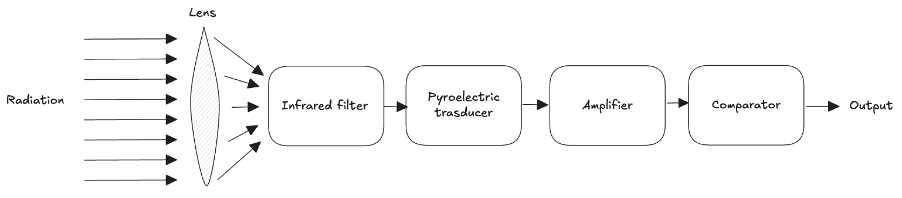
Detecting Presence (1)
Detecting the presence or absence of a person in a room
industrial automation, consumer electronics
Sensors: light, sound, pressure, motion, etc…
Passive Infrared PIR sensor
captures changes in infrared radiation emitted by objects in its field of view
human body heat causes a change in the infrared radiation
AM312 PIR sensor (see 01.DetectingMotion folder):
Lens expands the detection area and focus infrared radiation
Filter allows only IR of human body heat (8–14 µm wavelength)
Transducer exploits properties of some crystals to generate an electric charge when they are heated or cooled
The raw signal is weak and requires amplification

Slide 21

Detecting Presence (2)
01.DetectingMotion.ino

Slide 22
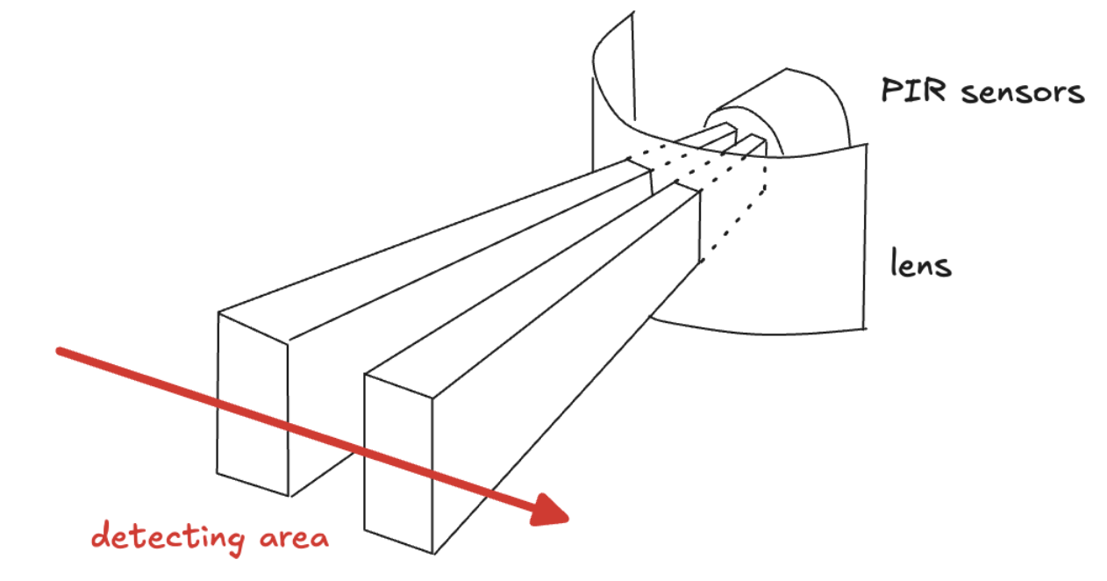
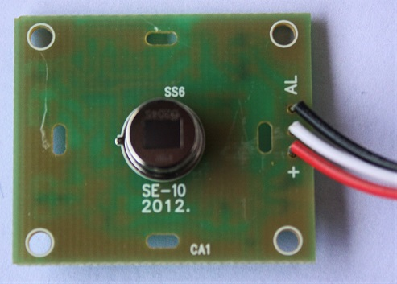
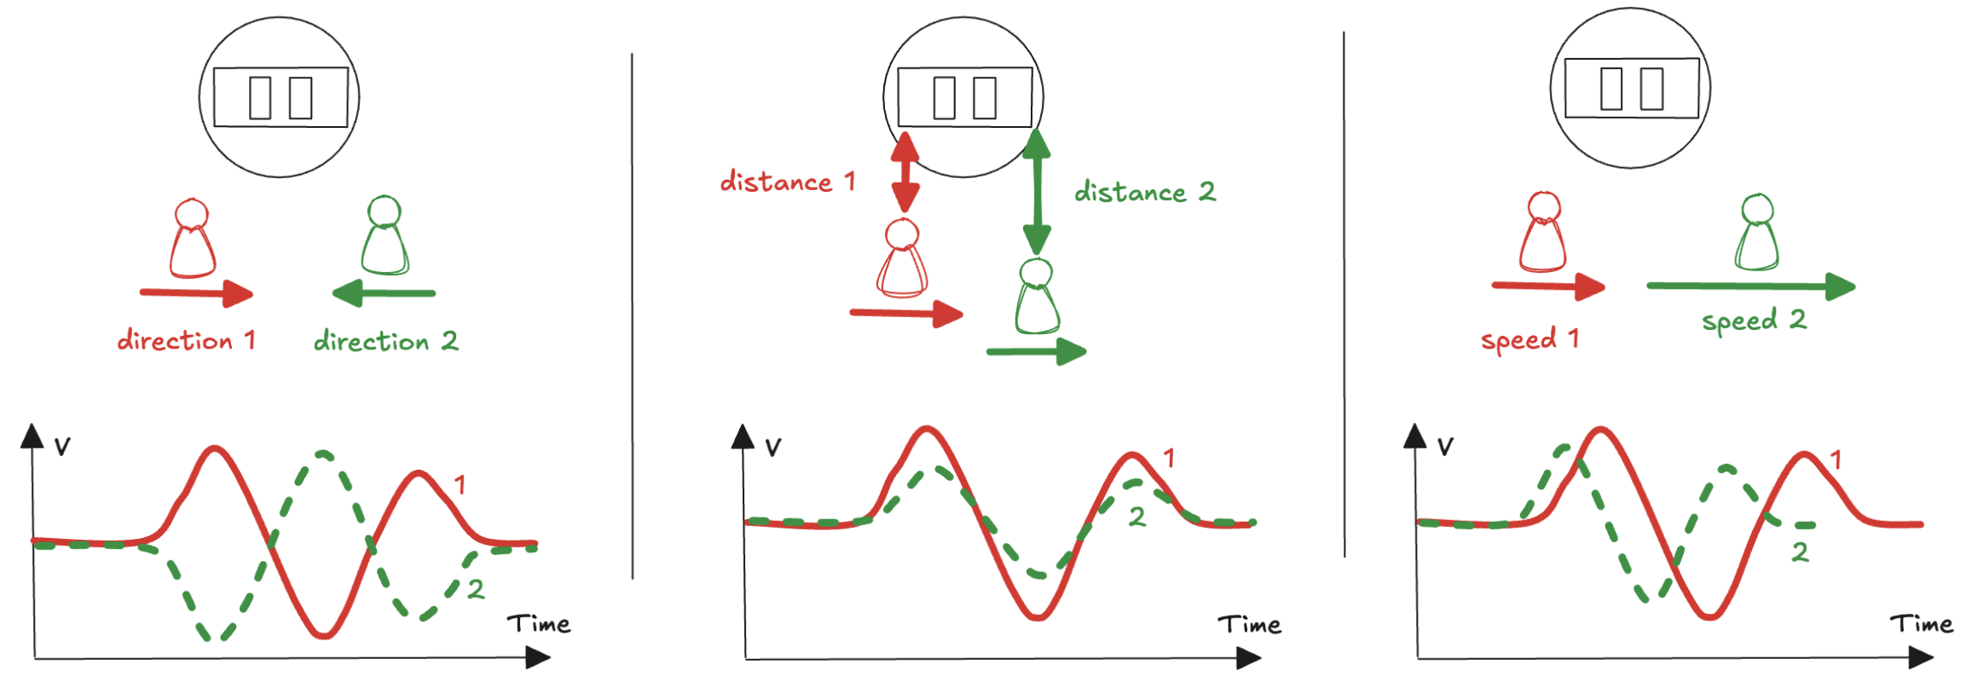
Detecting Motion
two slots made of an infrared sensitive material

Slide 23
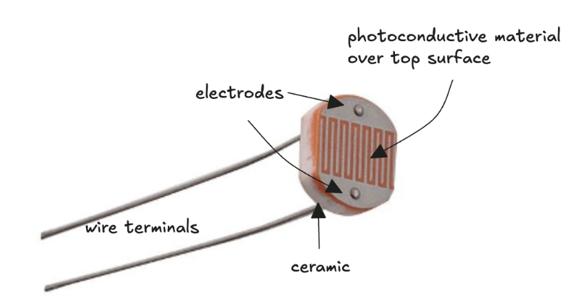
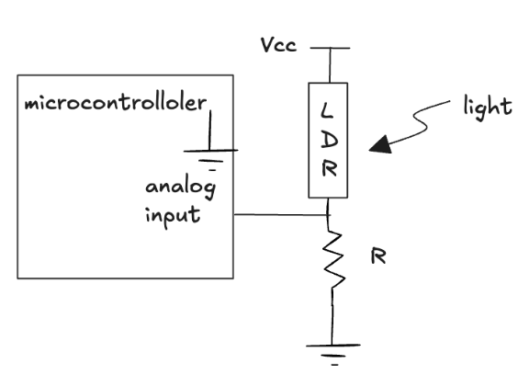
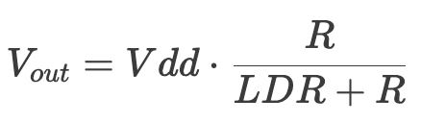
Detecting Light (1)
Photoconductivity
when light strikes a semiconductor materials (e.g. Cadmium Sulfide) , its energy excites electrons from the valence band to the conduction band
this increases material conductivity and decreases its resistance
Light Dependent Resistor (LDR)
Integrating the LDR into a voltage divider circuit
see 02.DetectingLight
Several limitations:
relationship between light intensity and resistance is highly non-linear
spectral sensitivity: responsive only to a specific range of wavelengths
slower response times
sensitivity to temperature

Slide 24

Detecting Light (2)
02.DetectingLight.ino

Slide 25
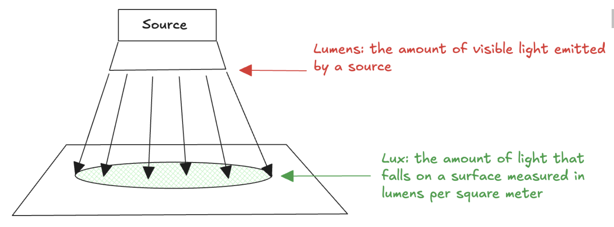
Light Measurement (1)
Lumens and Lux
Human eye perceive a wide range of light intensities
From as low as 0.0001 lux in starlight
Up to over 100,000 lux in direct sunlight
Difficult to build a sensor with the same sensitivity across the entire spectrum
TSL2561 sensor (see 03. MeasuringLight)
not a real luxmeter
characterized output against professional equipment
mimic characteristics of a camera (sensitivity setting, integration time, exposes)

Slide 26
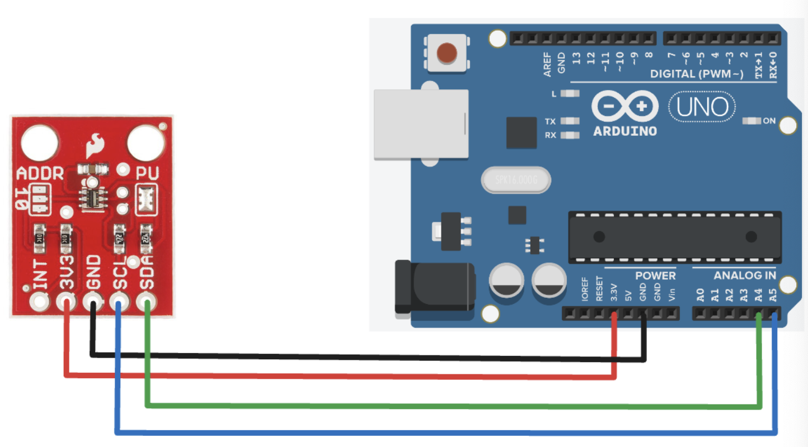
Light Measurement (2)
03. MeasuringLight.ino
SparkFunTSL2561 library

Slide 27
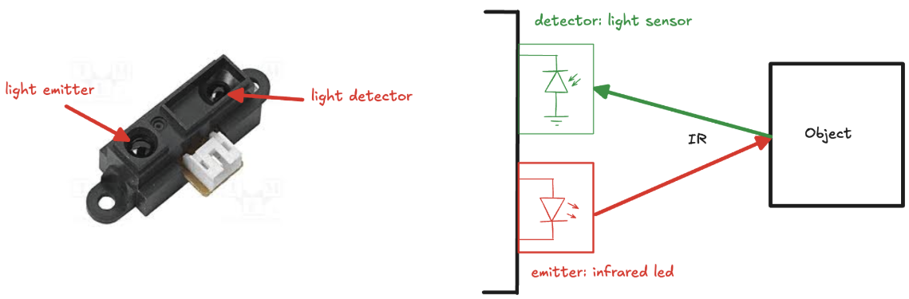
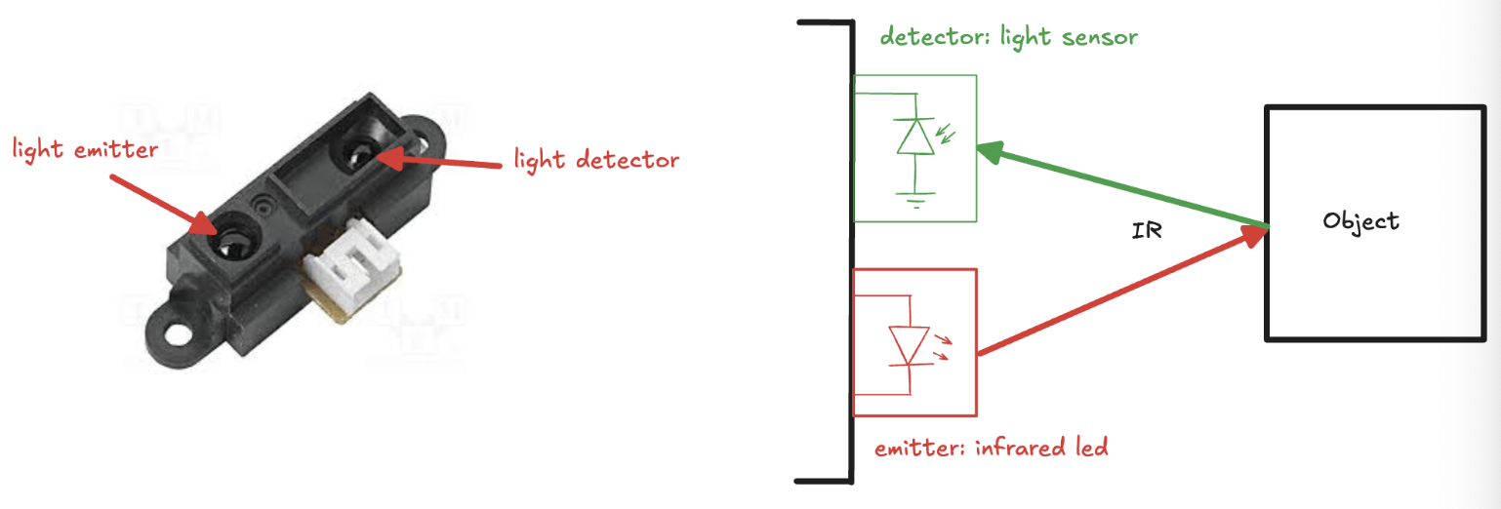
Measuring distance, using light (1)
Measure the distance of our embedded system from objects in the surrounding environment
Infrared (IR) sensor
a led produces light at the same wavelength as what a sensor is looking for
an external object close to the sensor produces a large jump in the intensity
used to determine the distance of the object
Time-of-Flight (ToF) sensor
emit a light pulse and measure the time it takes to return after reflection
by knowing the speed of light, we can calculate the distance to the object
Sharp GP2Y0A41SK0F sensor (see 04.MeasuringDistance_light folder)

Slide 28
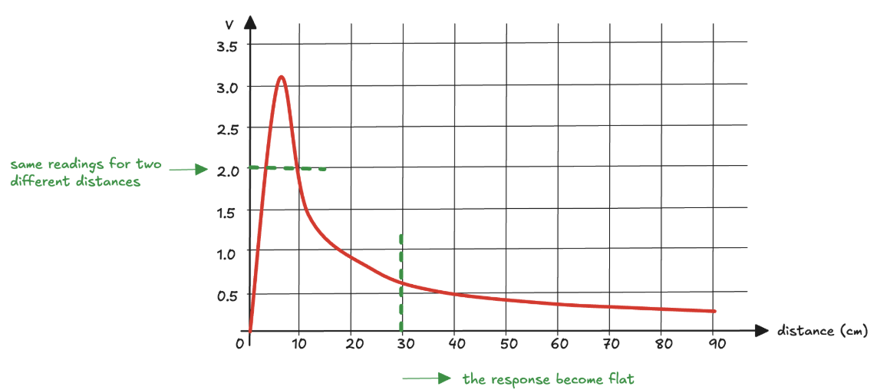
Measuring distance, using light (2)
The response is non-linear and even worse not monotonic
sensor cannot differentiate between distances producing the same voltage
limiting its effectiveness for objects closer than 4 cm
beyond 30 cm, the response becomes flat
Lookup table
to map the sensor's output to actual distances
created by recording the output at various known distances and interpolating

Slide 29
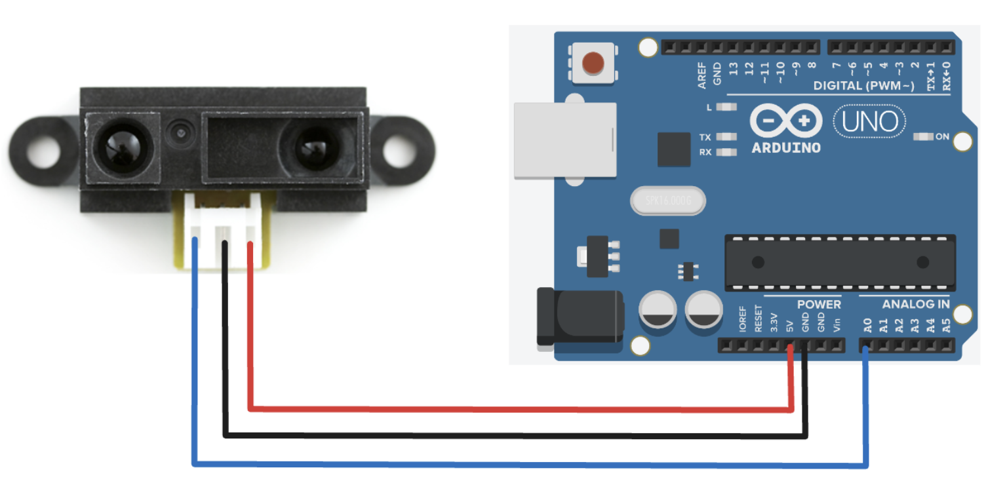
Measuring distance, using light (3)
04.MeasuringDistance_light.ino

Slide 30
Measuring distance, using sound (1)
An alternative approach: ultrasonic sensor
Emits ultrasonic sound waves
Measures the time it takes to bounce back after hitting an object
By knowing the speed of sound, we calculate the distance
Pros
greater accuracy and reliability across a wide range (from cm to meters)
suited for challenging environments (e.g. dusty, foggy conditions)
Cons
accuracy influenced by several factors (e.g. texture and angle of the object)
slower response time
HC-SR04 sensor (see 05.MeasuringDistance_sound folder)
microcontroller sends a 10 µs HIGH signal to the Trigger pin to activate the ultrasonic transmitter, which emits 8 cycles of a 40 kHz ultrasonic wave
The sensor waits for the echo to return, to calculate the time we can use the pulseIn() function

Slide 31

Measuring distance, using sound (2)
05.MeasuringDistance_sound.ino

Slide 32
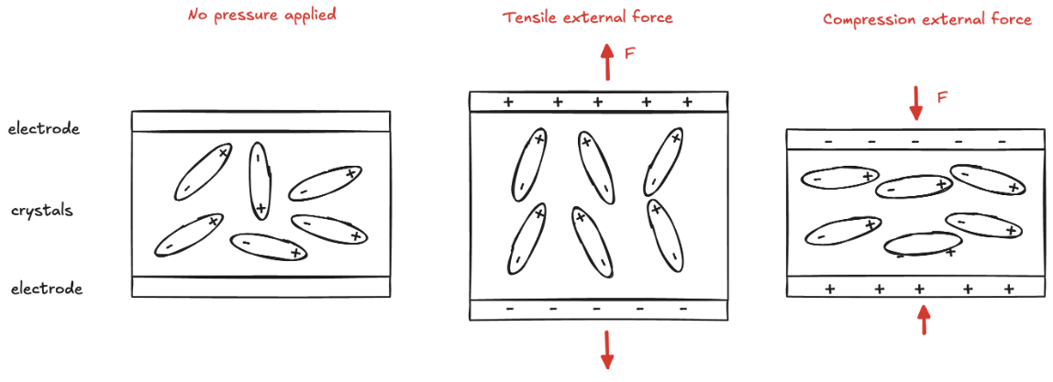
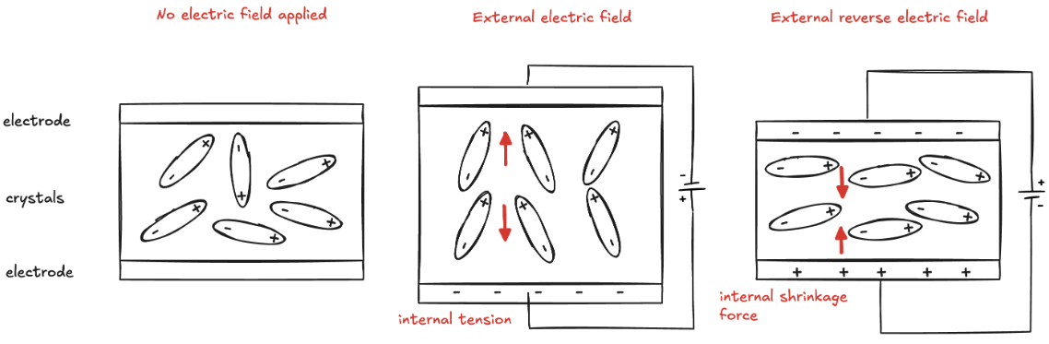
Detecting vibration (1)
Piezoelectric effect
Some materials (e.g. quartz, ceramics, polymers) generate an electric charge when subjected to mechanical stress
Inverse piezoelectric effect
Pressure sensors, accelerometers, and microphones
PKM22EPP-40 ( see 06.DetectingVibration folder)

Slide 33
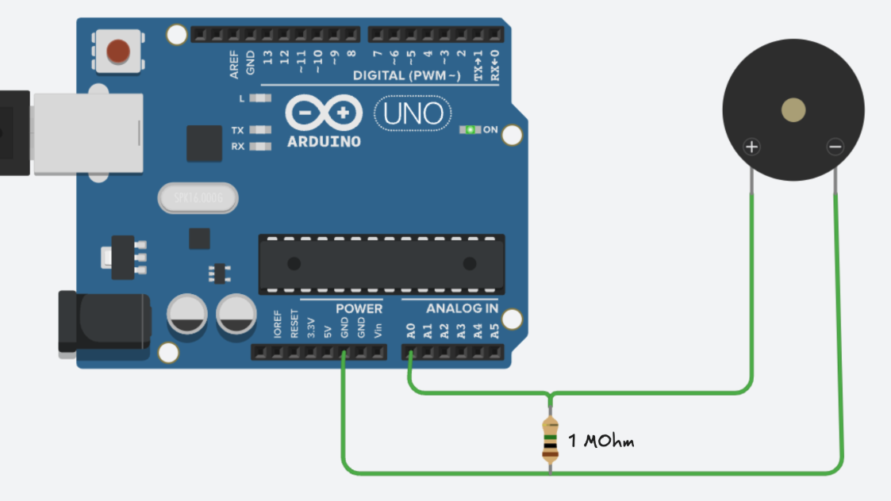
Detecting vibration (2)
06.DetectingVibration.ino

Slide 34
Measuring temperature (1)
Thermal sensor
the bandgap of a semiconductor varies with temperature, and this variation can be harnessed to produce a corresponding voltage or resistance signal
TMP102 sensor ( see 07.MeasuringTemperature folder)
A temperature sensor diode as the primary sensing element
The analog signal is converted into a 12-bit digital value
Resolution of 0.0625°C and
Accuracy of ±0.5°C
Operating temperature range: -25°C to +85°C
Digital logic to manages I2C protocol

Slide 35

Measuring temperature (2)
07.MeasuringTemperature.ino

Slide 36

Measuring physiological signals (1)
Photoplethysmograph (PPG)
blood absorbs light differently depending on its volume and oxygenation level
pulsatile signal corresponding to the rhythmic blood flow caused by the heartbeats
PulseSensor Kit ( see 08.PulseSensor folder)

Slide 37

Measuring physiological signals (2)
08.PulseSensor.ino

Slide 38
Self awareness
Enabling the embedded system to understand its state,
monitor performance
adapt to changing conditions
For example, the device orientation is critical in applications like navigation, gaming, and virtual reality
Deliver precise information to users
Adjust its behaviour dynamically
Seamlessly interact with its environment
We concentrate on how we can support orientation using different source of information
How we can combine them to improve the accuracy of the estimation using sensor fusion techniques

Slide 39

Accelerometer
Measure the total acceleration acting on it
dynamic forces from movement
static acceleration caused by gravity
Detect motion as well as orientation relative to the Earth's gravitational field
Notice the small size of the device: MicroElectroMechanical Systems (MEMS)

Slide 40


Gyroscope
Coriolis effect
a moving mass experiences a force that deviates its path when subjected to rotational motion
A suspended vibrating structure that responds to changes in angular velocity
when the device rotates, the vibrating element is affected by the Coriolis force, resulting in a shift perpendicular to its original vibration
displacement is minute, but it can be detected with high precision, often through capacitive or piezoelectric sensors

Slide 41

Magnetometer
Hall Effect
When a current flows through a thin, conductive plate, the charge carriers move in a straight line from one side of the plate to the other
When a magnetic field is applied perpendicular to the direction of the current, it causes the charge carriers to experience a force (Lorentz force)
The force causes the electrons to be deflected to one side of the plate, while the holes are pushed to the opposite side.
As a result, a voltage develops across the width of the plate, perpendicular to both the current and the magnetic field

Slide 42

Orientation
The position of an object in three-dimensional space relative to a reference frame, typically defined using three angles:
Yaw: rotation around the vertical (z-axis). How the object turns left or right
Pitch: rotation around the lateral (y-axis). The up or down tilt of the object
Roll: rotation around the longitudinal (x-axis). Tilting motion to the left or right
Together, these angles specify the orientation in 3D space

Slide 43





Orientation from accelerometer (1)
Leveraging accelerometer output in static condition (no motion), we can calculate the orientation of the body relative to the gravitational field
More generally, if the body is not perfectly aligned with the horizontal plane and considering the roll and yaw angles:
ICM-20948 sensor (see 09.PitchRoll folder)
3-axis accelerometer, 3-axis gyroscope, 3-axis magnetometer
a single chip: 9DOF (degrees of freedom) IMU (Inertial Measurement Unit)

Slide 44

Orientation from accelerometer (2)
09.Pitch_Accelerometer.ino

Slide 45

Orientation from accelerometer (3)
Experiment
Held the IMU and gently rotated in one direction and then in the opposite
The pitch angle is recorded and visualized
Accelerometer measures all forces acting on the object, not just gravitational acceleration
highly sensitive and easily disrupted by even minor disturbances
small forces like friction and vibrations can significantly alter the readings

Slide 46


Orientation from gyroscope (1)
We can repeat the experiment with gyroscope
We can estimate angular position by computing the integral of angular velocity over time
10.Pitch_Gyroscope.ino
Much more stable and less sensitive to external disturbances.
Small inaccuracies in each measurement accumulate over time, gradually deviating from the true angular position (drift)

Slide 47


Sensor fusion
Accelerometers and gyroscopes complement each other
Accelerometer is sensitive to all forces, which affect the measurement
Gyroscope provides accurate rotational data but tends to drift over time
Combine: leverage gyro short-term accuracy and accelerometer drift correction
Complementary filtering
11.Pitch_SensorFusion.ino
More advanced method for sensor fusion: Kalman filter

Slide 48
Hands-on Activity
1 - Adjust the brightness of an LED based on ambient light levels using Arduino Pulse Width Modulation (PWM). PWM controls brightness by rapidly switching the LED on and off, varying the proportion of time it stays on (duty cycle). This creates the effect of smooth dimming, as the human eye perceives the average light intensity rather than the rapid flickering. By adjusting the duty cycle in response to ambient light readings, the LED can automatically brighten in the dark and dim in well-lit conditions.
2 - Utilize the pitch and roll data to dynamically rotate a cube in 3D space along the corresponding axes. By continuously updating these values based on sensor readings, the cube will realistically respond to changes in orientation, simulating real-world motion.
3 - Display a real-time chart of heart rate data collected from the heart-rate sensor. Continuously update the graph to visualize heart rate variations over time, allowing for easy monitoring of trends, anomalies, or sudden changes in pulse.

